Slide 1
Investigation of the Secondary School Students’ Level of Curiosity about Science Subjects depending on the Variables of Grade Level and Gender
Assoc.Prof.Dr. Özgül KELEŞ
Prof.Dr. Naim UZUN
Aksaray University
Email: ozgulkeles@aksaray.edu.tr; naimuzun@yahoo.com

Slide 2
INTRODUCTION
Curiosity has been conceptualized as an internal drive, like hunger, pushing us to explore (Leslie, 2014). Curiosity is ‘a desire to understand various phenomena and a quest for knowledge’ (Pisula, 2009). Curiosity functions as a source of intrinsic motivation to learn, explore and investigate the environment (Silvia, 2008).

Slide 3
As curiosity ensures that people develop a broad set of knowledge, skills and experience, it plays a fundamental role in human cognitive, social, emotional, spiritual and physical development, education and scientiﬁc discovery (Silvia, 2008).

Slide 4
Overall, curiosity is considered a multidimensional construct represented by cognitive, physical and social factors (Reio et al., 2006), it can emerge from both social and non-social stimuli, and it has a profound inﬂuence on one’s well-being (Kashdan & Silvia, 2009).

Slide 5
Dewey believed that curiosity is the most essential component of learning. Curiosity motivates learning and academic performance: People who are more interested in given content spend more time reading a text, persist longer at the learning tasks, process the information more deeply, remember more of what they read and get better grades in class (Silvia, 2005, 2008).

Slide 6
Curiosity and questioning go hand-in-hand in the development of higher-level thinking skills and teaching for understanding. Curiosity fuels imagination and leads to wonderment; thus it is a prerequisite to good questioning. Engagement is sparked by curiosity; then deep thinking is guided by the question. So curiosity is a critical factor in the learning process, both as a motivator and a facilitator.

Slide 7
Scientiﬁc curiosity can be deﬁned as a desire to understand and a quest for knowledge regarding natural phenomena (Krapp & Prenzel, 2011). Like other content-speciﬁc curiosities, scientiﬁc curiosity will also cause the curious person to behave in a certain way; to take certain courses of action and to practice different skills that will enable the revelation of new pieces of information.

Slide 8
The act of discovery starts with the sense of curiosity. Through the sense of curiosity, students starts to make sense of objects and events around them .They research and question to learn the things they wonder about. Science classes involve many subjects that can nurture students’ sense of curiosity. Therefore, the sense of curiosity is one of the important elements affecting science education.

Slide 9
PURPOSE OF THE STUDY
Different variables may affect the sense of curiosity positively or negatively. Detection of what these variables are and then taking the necessary precautions might contribute to the development of sense of curiosity and science education. In this regard, the current study aimed to investigate the secondary school students’ level of curiosity about science subjects (5th-8th graders) depending on the variables of grade level and gender.

Slide 10
RESEARCH QUESTIONS
For this purpose, the following sub-problems have been searched;
Do the students' curiosity scores for science subjects significantly different according to gender and class?
Do the students' curiosity scores for science subjects significantly different from the gender and the common effect of class?

Slide 11
METHODS
Participants
The study group of the current research is comprised of a total of 455 students attending 7 different secondary schools. Of the participating students, 49.2% are girls, 50.8% are boys. Of the students, 23.7% are fifth graders, 18.5% are sixth graders, 36.9% are seventh graders and 20.9% are eighth graders.

Slide 12
Data Collection Tool
In order to collect data, “Science Curiosity Scale” developed by Serin (2010) was used. The original form of the Science Curiosity Scale is a 30-item scale designed in the form of 5-point Likert scale ranging from “Strongly agree: 5” to “Strongly disagree: 1”.

Slide 13
Data Collection Tool
As a result of the factor analysis, final form of the scale was given to include 19 items. The minimum score to be taken from the scale is 19 and the maximum score to be taken from the scale is 95.
Cronbach alpha coefficient calculated for the Science Curiosity Scale was found to be α=.91.

Slide 14
Data Analysis
In order to determine whether the data are suitable for factor analysis, Kaiser-Meyer-Olkin (KMO) coefficient was calculated and was found to be .931. Barlett Sphericity test was also found to be significant (Significance =.000; p<.001). In the analysis of the data, SPSS was used (descriptive statistics and Two-Way ANOVA).

Slide 15
FINDINGS

Slide 16
The 5th, 6th and 7th grade female students’ level of curiosity about science subjects ( =86.00; 85.02 and 83.27, respectively) is higher than that of the male students ( = 80.19; 77.66 and 76.49, respectively). Though the 8th grade students’ level of curiosity does not vary significantly by gender, it differs in favor of the male students.

Slide 17
Table 2: Results of ANOVA on Curiosity Points for Science Subjects according to Grade and Gender Variables
Source | Sum of Squares | df | Mean Square | F | p | η²
Corrected Model | 4896,863 | 7 | 699,552 | 3,982 | ,000 | ,059
Intercept | 2699507,181 | 1 | 2699507,181 | 15367,307 | ,000 | ,972
Grade | 1140,172 | 3 | 380,057 | 2,164 | ,092 | ,014
Gender | 2568,220 | 1 | 2568,220 | 14,620 | ,000 | ,032
Grade* Gender | 837,898 | 3 | 279,299 | 1,590 | ,191 | ,011
Error | 77819,860 | 443 | 175,666
Total | 3005873,000 | 451
Corrected Total | 82716,723 | 450

Slide 18
A significant difference was found between the curiosity mean scores of the female students and the male students (F(1-443) =14.620; p<.001).

Slide 19
The students’ mean curiosity scores do not vary significantly depending on the grade level variable (F₍₃₋₄₄₃₎ =2.164; p>.05). These findings show that gender is an important variable significantly affecting secondary students’ level of curiosity about science subjects and can explain 3.2% of the dependent variable (η²=.032).

Slide 20
Moreover, the common effect of grade level and gender on the secondary school students’ curiosity scores was not found to be significant (F₍₃₋₄₄₃₎ =1.590; p>.05).

Slide 21
RESULTS AND DISCUSSION
In the findings obtained from the research, it was determined that 5th grade students participating in the research showed significant differences in curiosity scores for science subjects by sex. At 5th, 6th and 7th grade levels, female students' curiosity scores for science subjects are higher than male students.

Slide 22
Although the scores of the 8th grade students are similar to each other according to sex, they differ in favor of male students. This finding indicates that gender is an important variable on curiosity scores for science subjects.

Slide 23
In a study in which the curiosity of 7th grade pupils was determined, it was found that pupils were generally curious; The level of science curiosity of female students was found to be higher than male students (Ceylan et al., 2016).

Slide 24
Some studies on students' curiosity about science knowledge have led in particular to the fact that girls are more interested in biology subjects, physics subjects are more interested in men, and curiosity is declining in later ages (Greenfield, 1997; Dawson, 2000; Baram- Tsabari & Yarden, 2005).

Slide 25
Serin (2010) research found that the level of science curiosity of 7th grade girl students was higher than that of male students. At PISA 2012, the average of girls in the science field is higher than the average of males.

Slide 26
According to the grade variable, it was determined that students' curiosity scores for science subjects did not show any significant difference. It was also found that the common effect of grade and gender students on curiosity scores for science subjects was not significant.

Slide 27
REFERENCES
Baram-Tsabari, A. ve Yarden A. (2005). “Characterizing Children’s Spontaneous Interests in Science and Technology”. International Journal of Science Education, 27(7): 803-826.
Ceylan, E., Sağırekmekçi, H., Tatar, E., & Bilgin, İ. (2016). Ortaokul Öğrencilerinin Merak, Tutum ve Motivasyon Düzeylerine Göre Fen Bilgisi Dersi Başarılarının İncelenmesi. Uşak Üniversitesi Sosyal Bilimler Dergisi, 9(1), 39-52.
Greenfield, T. A. (1997). “Gender and grade level- Differences in science interest and participation”. Science Education, 81: 259-276.

Slide 28
REFERENCES
Kashdan, T.B., & Silvia, P.J. (2009). Curiosity and interest: The beneﬁts of thriving on novelty and challenge. In S. Lopez & C.R. Snyder (Eds.), Oxford handbook of positive psychology (pp. 367–374). New York, NY: Oxford University Press.
Leslie, I. (2014). Curious: The desire to know and why your future depends on it. Philadelphia: Basic Books.
Pisula, W. (2009). Curiosity and information seeking in animal and human behavior. Boca Raton, FL: Brown Walker Press.
Reio, T.G., Petrosko, J.M., Wiswell, A.K., & Thongsukmag, J. (2006). The measurement and conceptualization of curiosity. The Journal of Genetic Psychology, 167(2), 117–135.

Slide 29
REFERENCES
Serin, G. (2010). İlköğretim 7. Sınıf Öğrencilerin Fene Karşı Meraklarının İncelenmesi. Mustafa Kemal University Journal of Social Sciences Institute 7(13), 237 – 252.
Silvia, P.J. (2005). What is interesting? Exploring the appraisal structure of interest. Emotion, 5(1), 89–102.
Silvia, P.J. (2008). Interest-The curious emotion. Current Directions in Psychological Science, 17(1), 57–60.

Slide 30
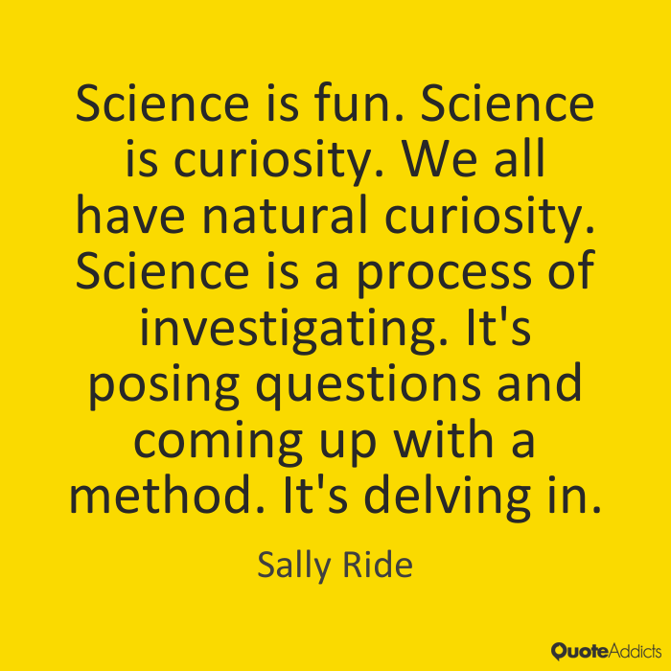
THANK YOU FOR YOUR LISTENING

